Slide 1

“PREVENTION OF CARDIO METABOLLIC RISK USING SMART GAS ANALYZER”
SCHOOL OF COMPUTING
DEPARTMENT OF COMPUTER SCIENCE & ENGINEERING
10214CS701- MAJOR PROJECT
WINTER SEMESTER 2024-2025
MAJOR PROJECT INHOUSE
SUPERVISED BY
Dr.N.Gomathi/Professor
PRESENTED BY
P.REKHA SHANMUKHI(VTU19523)(21UECS0454)
S.GOPINADH(VTU19522)(21UECS0560)
P.NEERAJA (VTU 19613)(21UECS0483)
1/25/2025
BATCH NO : 25
DEPARTMENT OF COMPUTER SCIENCE & ENGINEERING
1

Slide 2
AGENDA
Introduction/Overview
Background/Literature Review,Gap Analysis
Proposed Solution/Methodology Implementation Plan/Timeline
Expected Outcomes/Deliverables Challenges and Mitigation Strategies
Conclusion and Future Work
BATCH NO :

Slide 3
Introduction/Overview
Problem Statement:
Develop a Smart Gas Analyzer to non-invasively and affordably detect cardio-metabolic risk biomarkers in real-time using advanced sensors and AI.
Project Goal:
The goal of the project is to develop a non-invasive, affordable, and AI-powered Smart Gas Analyzer for real-time detection and
prevention of cardio-metabolic risks by analyzing biomarkers in exhaled breath.
Brief Overview:
The system uses advanced sensors to analyze breath biomarkers, AI algorithms to assess cardio-metabolic risks, and real-time monitoring for early prevention.
BATCH NO :

Slide 4
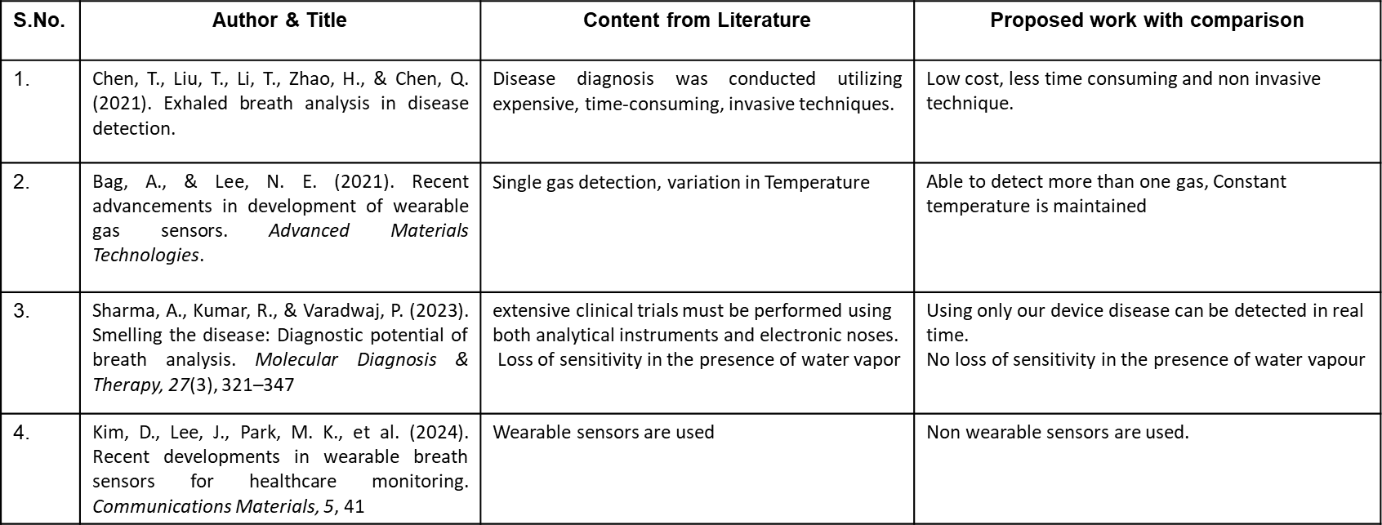
Background/Literature Review
BATCH NO :

Slide 5
Existing Solutions/Related Work:
Current solutions include blood tests and wearable devices for monitoring cardio-metabolic risks, but they are invasive, expensive, or lack real-time capabilities. Gas analyzers have been used to detect biomarkers, but they often lack AI-driven analysis and comprehensive risk prediction for early prevention.
Limitations of Existing Solutions:
Existing solutions are often invasive, costly, and lack real-time monitoring, making them impractical for continuous and widespread use. Additionally, many gas analyzers lack AI-driven analysis, limiting their accuracy and predictive capabilities.
How Your Project Differs/Improves:
The Smart Gas Analyzer improves upon existing solutions by offering a non-invasive, real-time diagnostic tool that uses advanced sensors to detect cardio-metabolic risk biomarkers in breath. It integrates AI-driven algorithms for accurate risk assessment and continuous monitoring, making it more affordable, accessible, and precise compared to current costly, invasive, and limited alternatives.
BATCH NO : 25

Slide 6
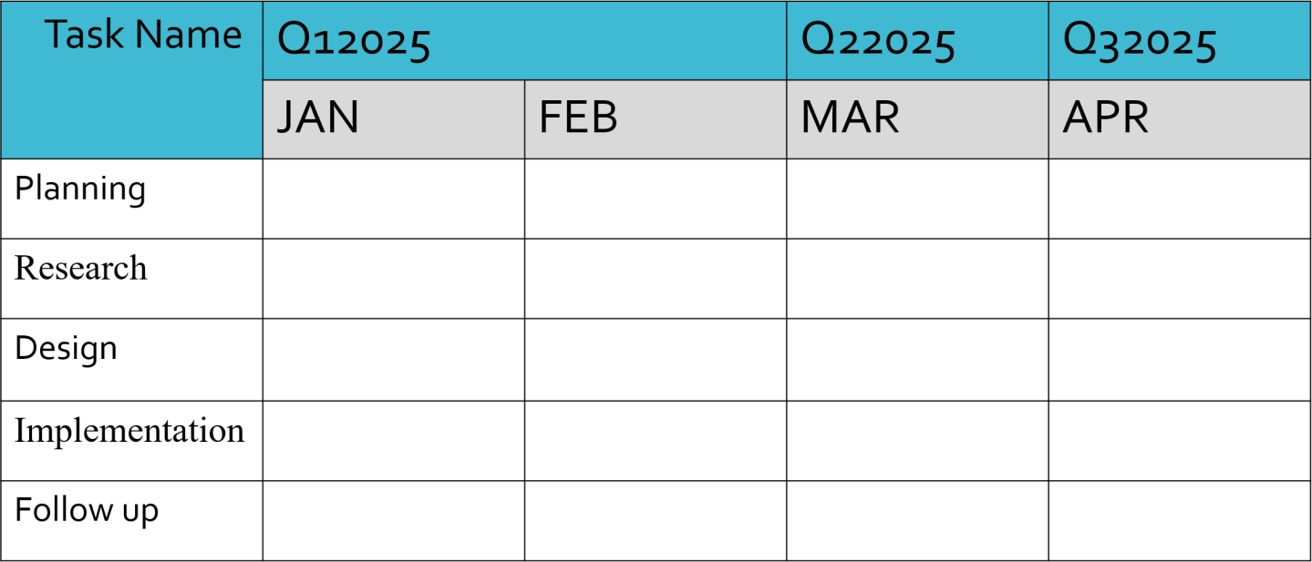
Implementation Plan/Timeline
BATCH NO :

Slide 7

Expected Outcomes/Deliverables
Concept In Business
Expected Results:
AI-enhanced risk prediction with high accuracy and reliability.
Improved accessibility and affordability compared to current invasive diagnostic methods.
Real-time, continuous monitoring of biomarkers for early detection and prevention of cardio-metabolic risks.
Deliverables :
A comprehensive dataset of biomarkers and risk assessments.
AI algorithms for accurate analysis and risk prediction.
Final project report, including testing results and potential for scaling the solution.
A working prototype of the Smart Gas Analyzer.
BATCH NO :

Slide 8
Challenges and Mitigation Strategies
Potential Challenges:
Ensuring the accuracy and sensitivity of the gas analyzer in detecting specific biomarkers amidst mixed gases in breath samples. Additional hurdles include maintaining affordability, ensuring user-friendliness, adhering to healthcare regulations, and integrating AI algorithms effectively for real-time and reliable risk prediction.
Mitigation Strategies:
Collaborating with healthcare and engineering experts to enhance sensor accuracy and AI reliability, while iterative prototyping ensures functionality and cost-effectiveness. Early regulatory compliance, extensive testing, and user-centric design will address technical, legal, and usability challenges effectively.
BATCH NO :

Slide 9
Conclusion
Summary:
The Smart Gas Analyzer offers a transformative solution for non-invasive, real-time detection of cardio-metabolic risks by leveraging advanced sensors and AI-driven analysis. This innovative approach aims to enhance early prevention, improve accessibility, and bridge critical gaps in existing diagnostic methods, contributing significantly to better healthcare outcomes.
BATCH NO :

Slide 10
THANK YOU!
BATCH NO :

